Slide 1
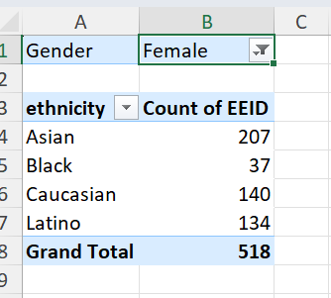
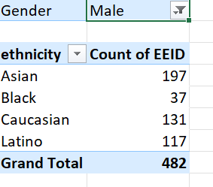
SUMMARY OF GENDER AND ETHNICITY DISTRIBUTION INSIDE OF COMPANY
INFERENCE: From the employee dataset , highest no of people (male& female) from Asian ethnicity. In comparison with male and female , females were more in the company. From the count of employee id, I got this observation. In the next slide I have included entire calculation based on percentage of count.

Slide 2
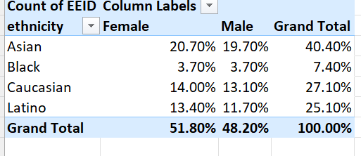
Step 2

Slide 3
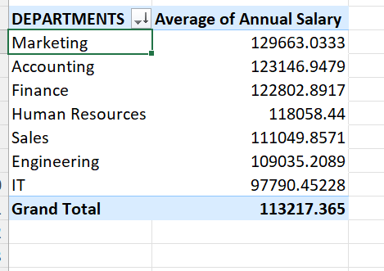
3) SIGNIFICANT DIFFERENCE IN AVG SALARIES BETWEEN DIFFERENT DEPARTMENTS
INFERENCE:
Yes , there is significant change in avg salaries between dif departments. Here we may see the highest avg salary for marketing team(114%) in compared to all others.It team opt the less salary compared to all others.By this we can get to know that marketing team is a main part of the company.
Lets see how the percentage of their salary is

Slide 4
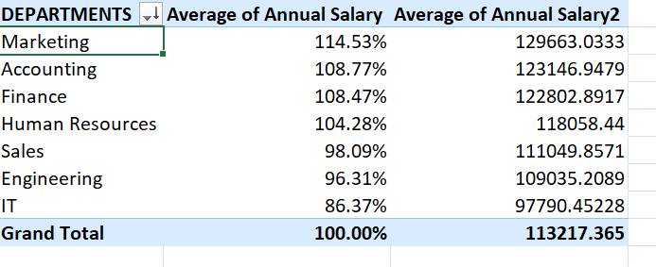

Slide 5
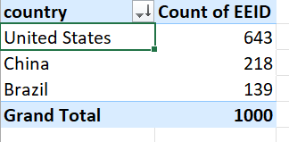
4)Which company is having highest no. of employees
INFERENCE:
US is having the highest no. of employees compared to other countrys.Brazil opt the lowest no. of employees.

Slide 6
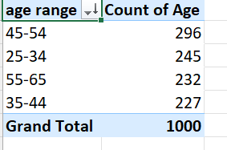
Most common age range among employees
INFERENCE:
Age range from 45-54 people were having the highest count in the company,

Slide 7
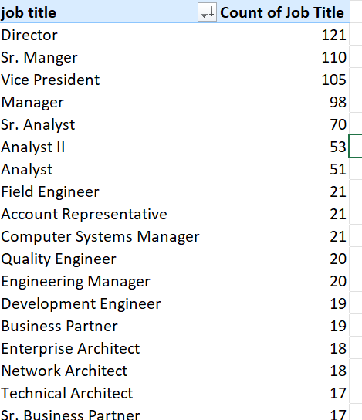
Which job title occurs mostly in the data set
INFERENCE:
Director position Is the mostly occurring job title in data set.121 people are in that position

Slide 8
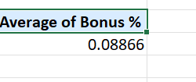
Average bonus percentage given to employees

Slide 9
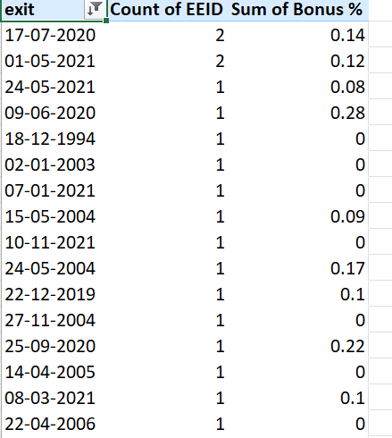
Primary reason cited for employee exit
INFERENCE:
The main reason for the exit is because of low bonus . The percentage of bonus they have compared to others were very low.

Slide 10
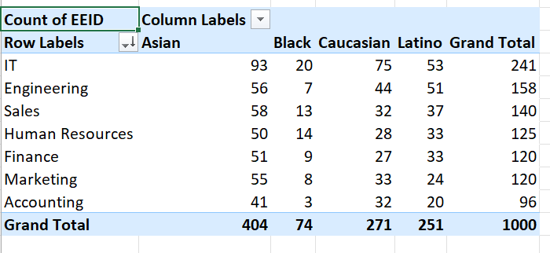
9) Diverse in ethnicity
IT department is having diverse ethnicity

Slide 11
10)

